Slide 1

Team members:
Jessica Carpenter
Thomas Chavez
Guanbo Bian
Beer Preferences Across America
Guanbo Bian, Jessica Carpenter, Thomas Chavez
Notes:
Thomas

Slide 2

Questions to answer:
Are there outliers in the dataset?
What attributes should be considered in forming clusters?
Does correlation exist between any of the attributes?
Can the results be used to estimate what influences overall taste/perception of a beer?
Notes:
Thomas

Slide 3
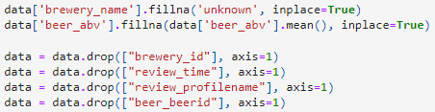
Data preparation work
Check for null values and investigate outliers
Remove outliers and Replace nulls with appropriate values
Remove irrelevant/redundant attributes based on scope of work
Notes:
Thomas

Slide 4

Tools Used
Pandas and NumPy
Useful for storing, manipulating, and transforming data
Matplotlib
Visualization library to aid in comprehending data and identifying trends
Seaborn
Also used for visualizations which offers alternative tools such as KDE and Dist plots.
Sklearn
Useful for implementing machine learning algorithms such as KNN and Linear Regression
Plotly
Useful for graphing purposes
Notes:
Jessica

Slide 5
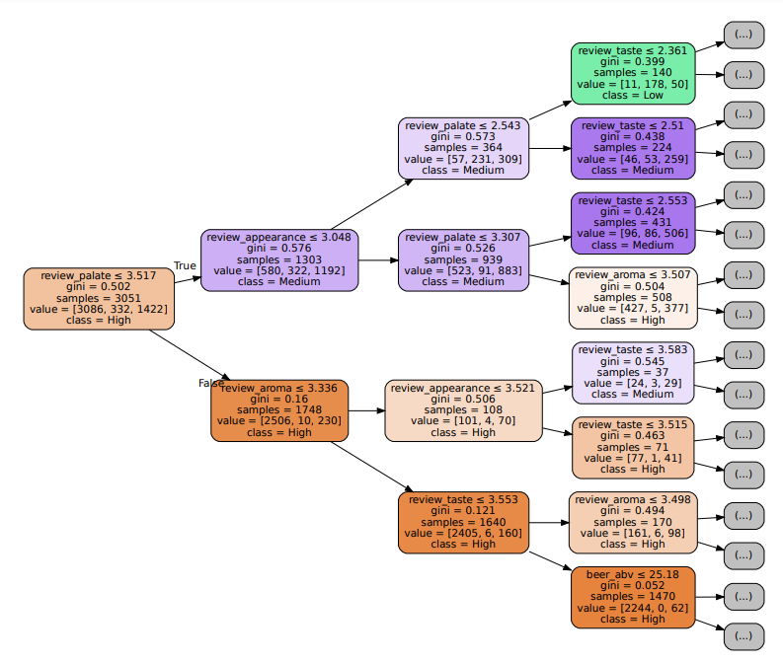
Linear Regression
K-means Clustering
Decision Tree
Classification applied
Notes:
Jessica

Slide 6
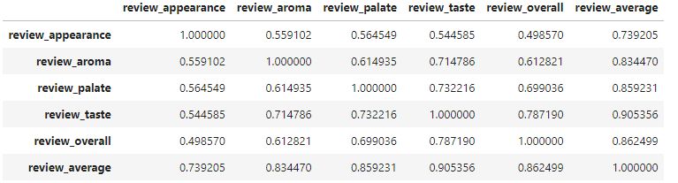
Knowledge gained
Overall rating highly influenced by taste and palate
Aroma and appearance are also correlated but not as much of an influence
ABV is a factor but is independent of other attributes
Notes:
Guanbo

Slide 7
Beer reviews offer insights into evolving customer preferences, preferred characteristics, and preferred beer styles
Breweries can balance effort/cost to optimize ABV level
Depending on customer behavior, e-commerce applications can direct consumers to appropriate stores, breweries, and brands.
Applications
Notes:
Guanbo

